Slide 1
IPL DATAANALYSIS
File created on: 12-05-2024 16:36:48

Slide 2
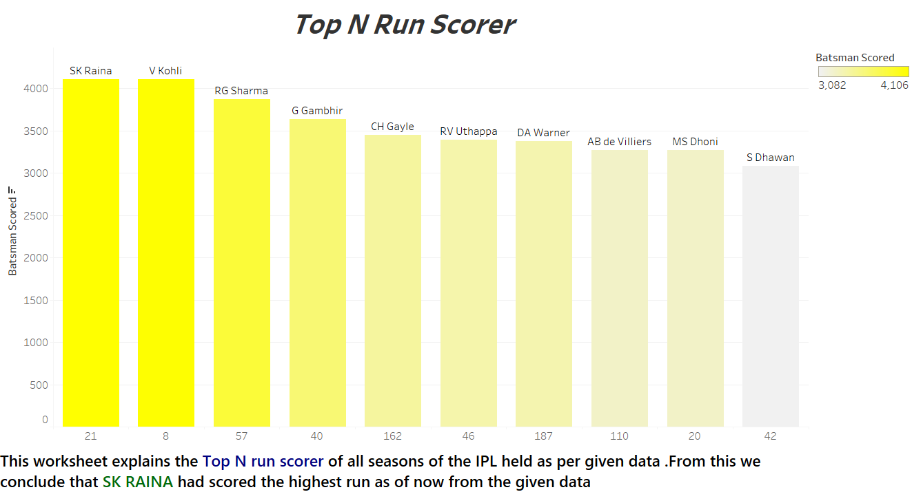

Slide 3
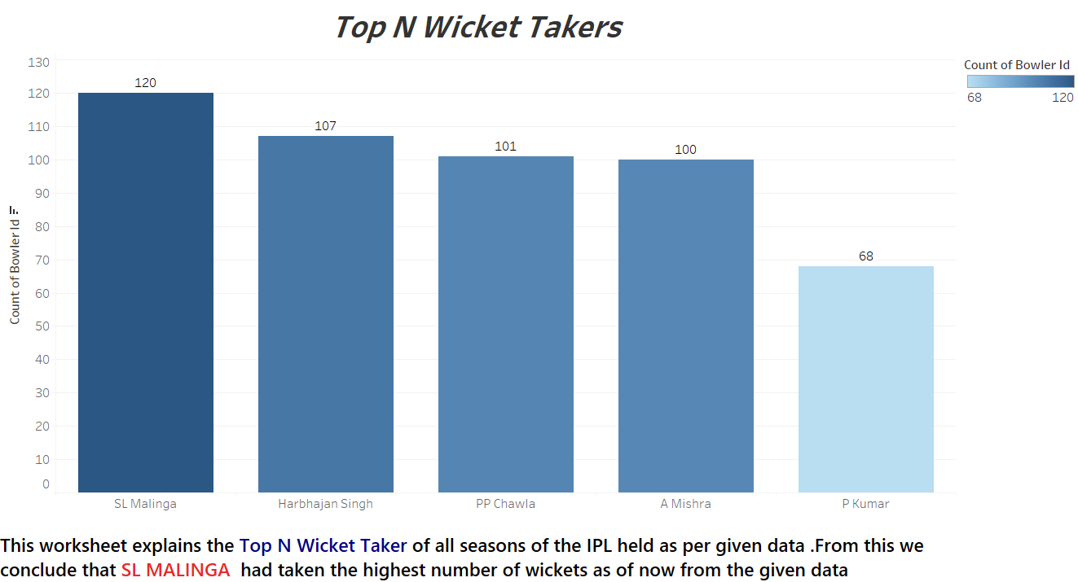

Slide 4
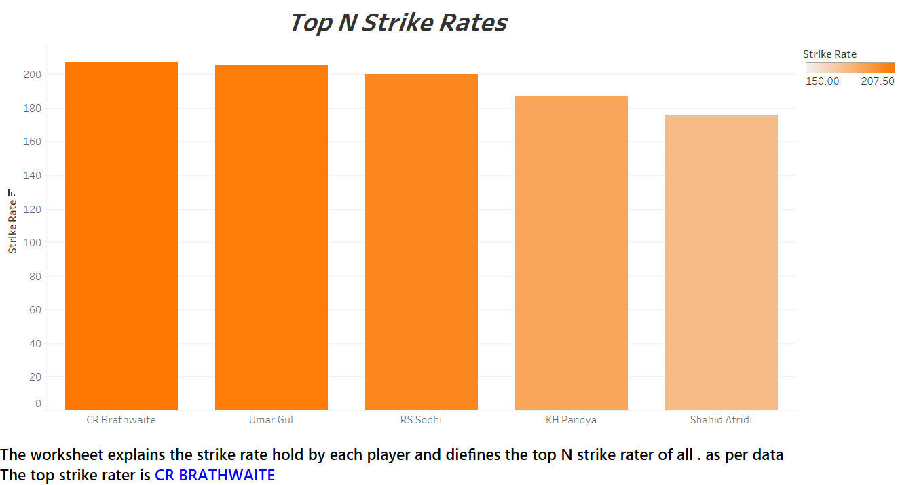

Slide 5
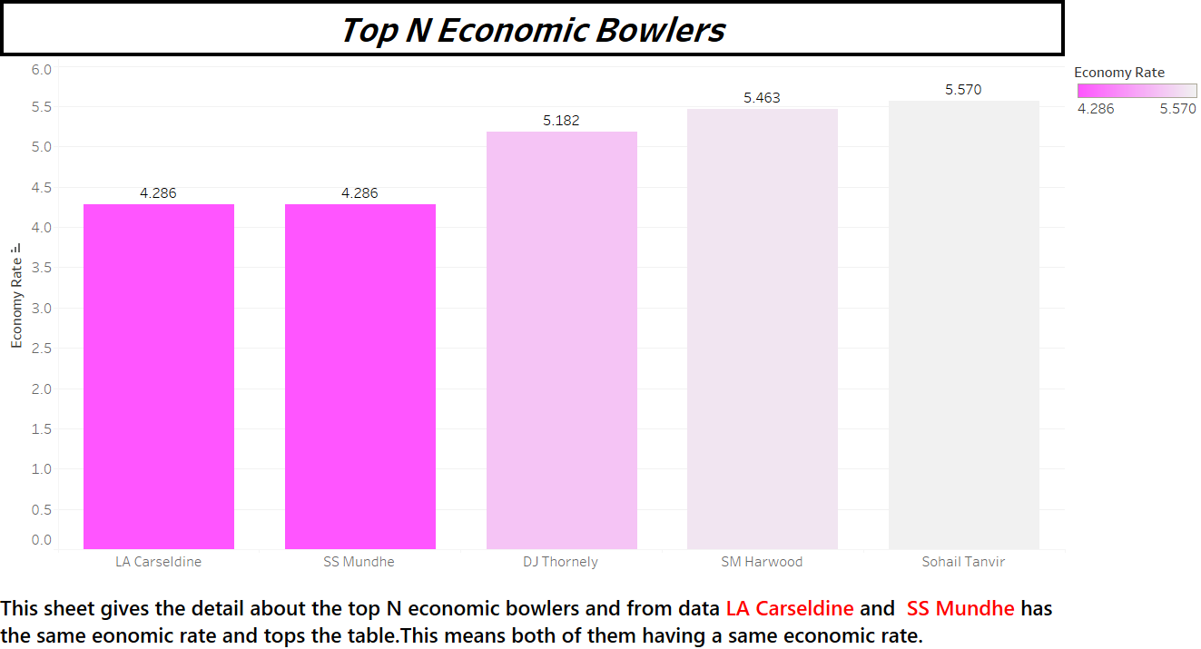

Slide 6
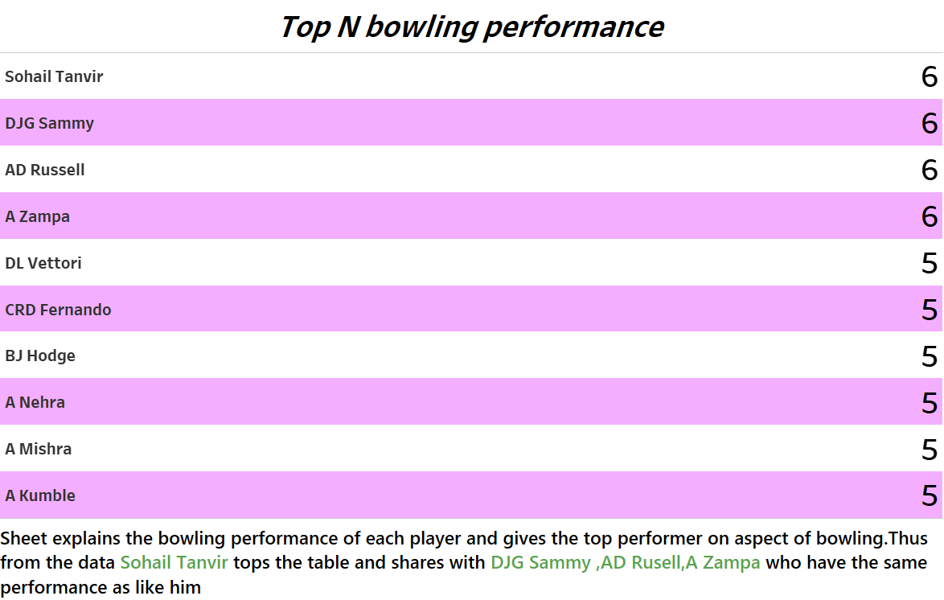

Slide 7
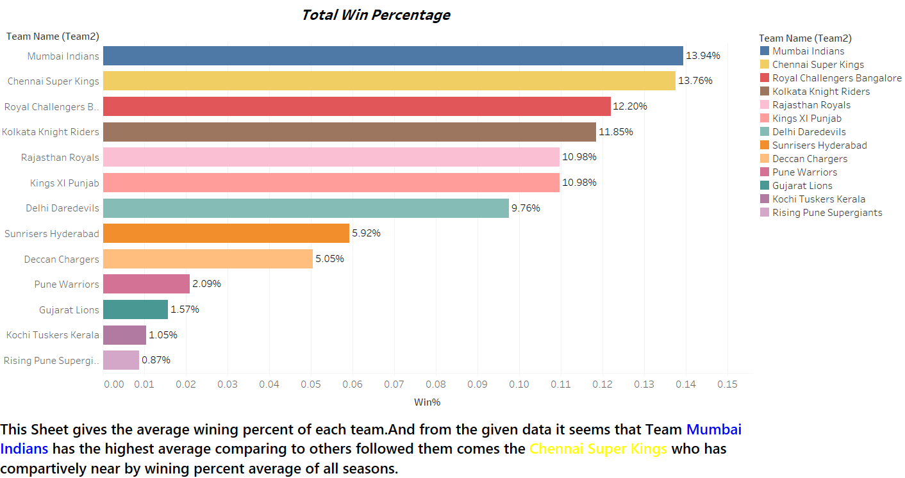

Slide 8
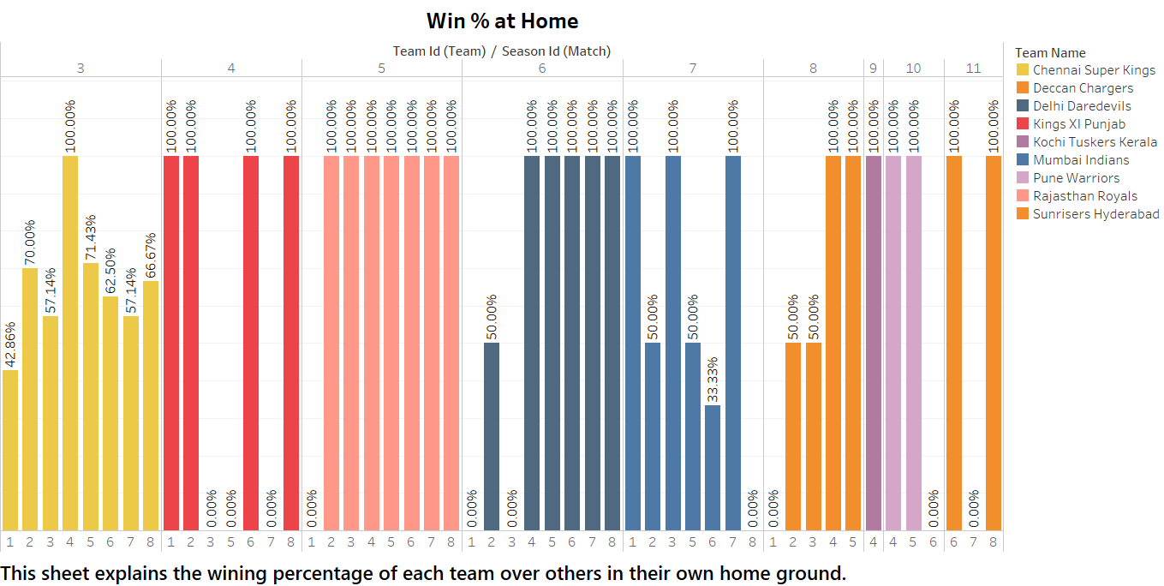

Slide 9
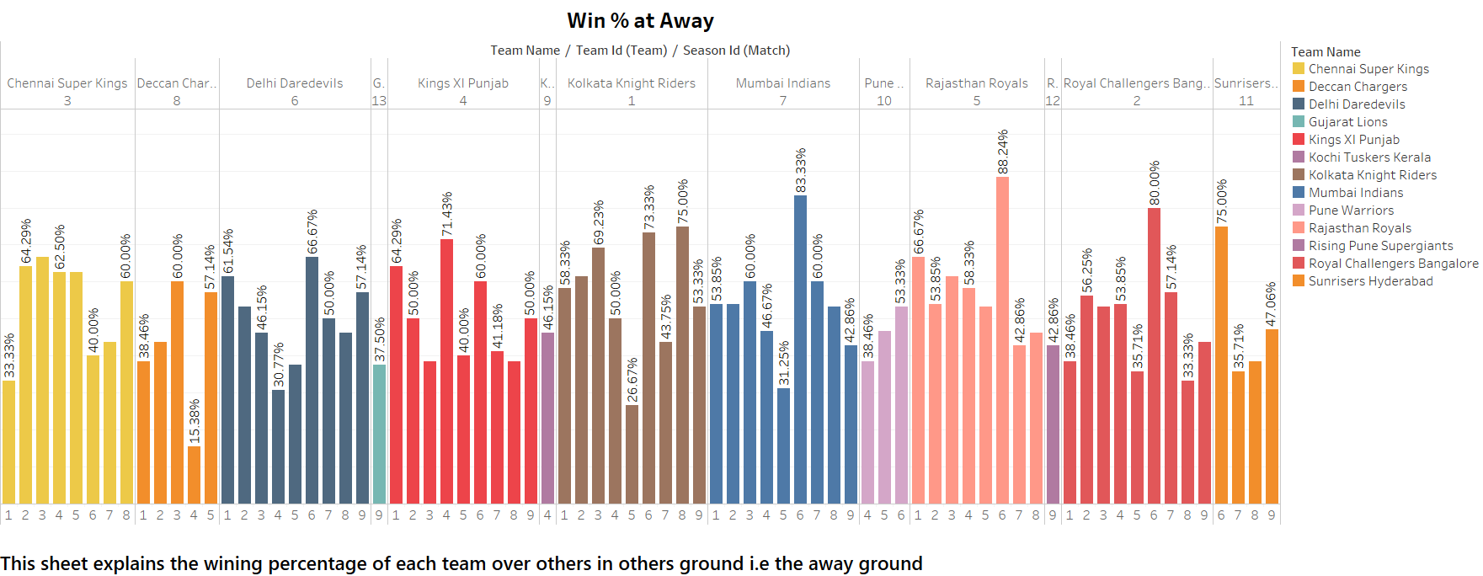

Slide 10
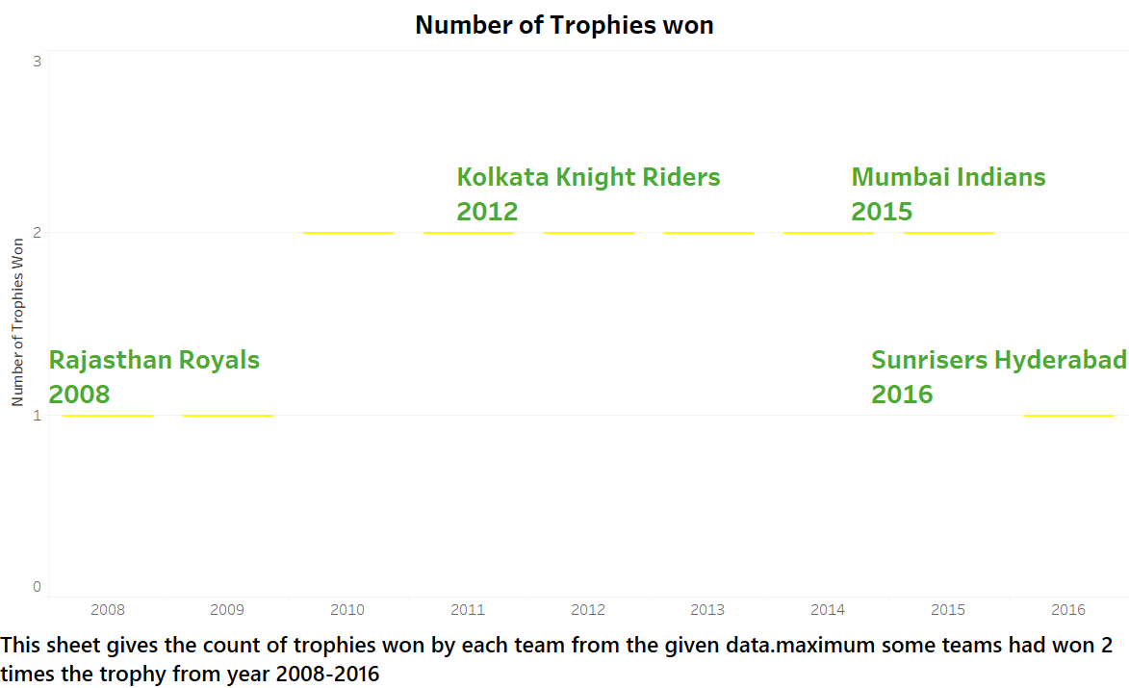

Slide 11
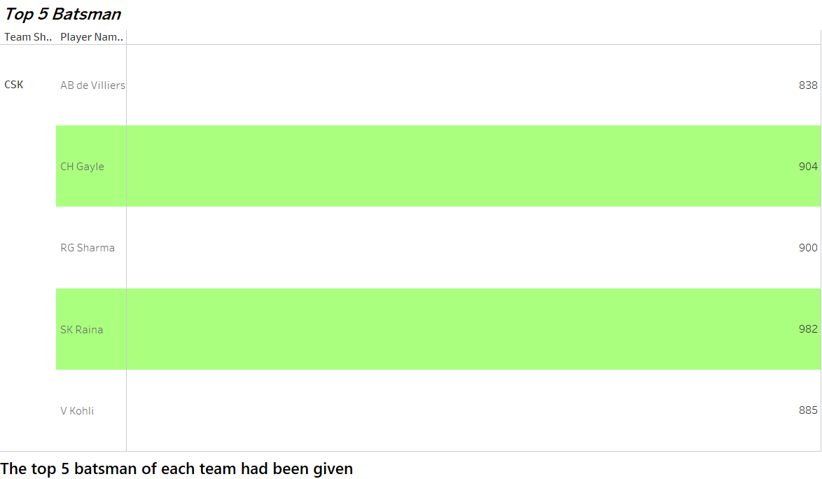

Slide 12
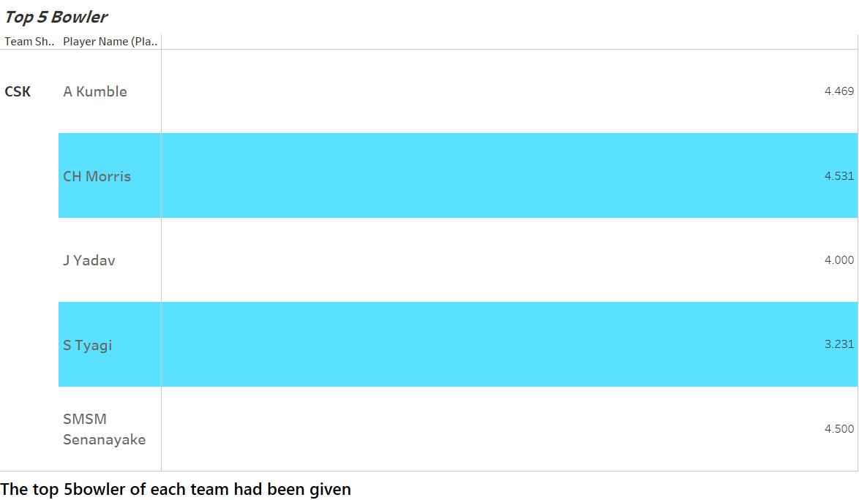

Slide 13
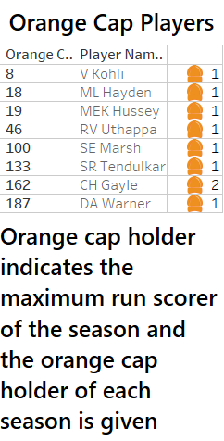

Slide 14
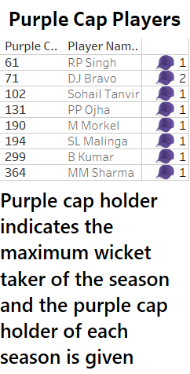

Slide 15
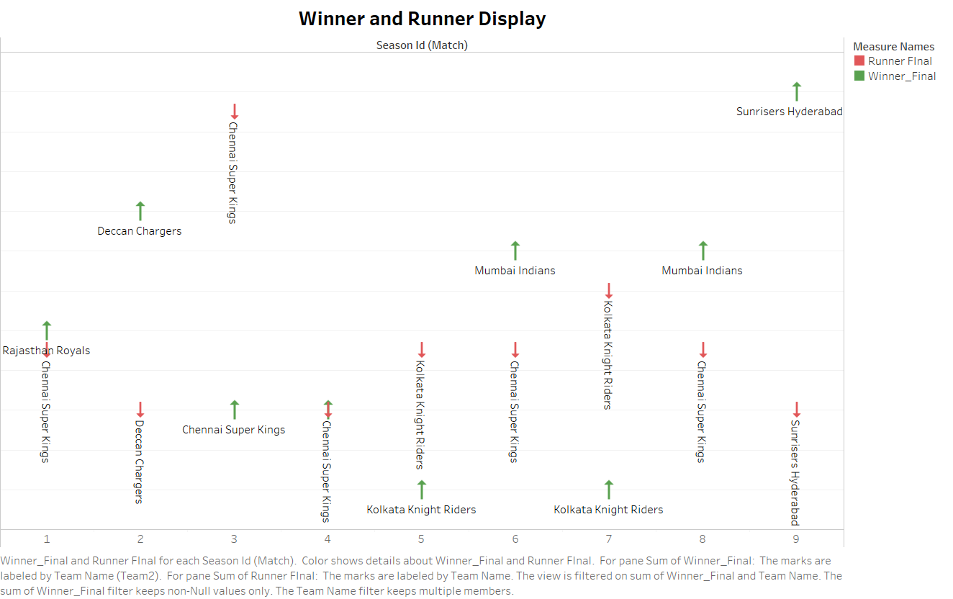

Slide 16
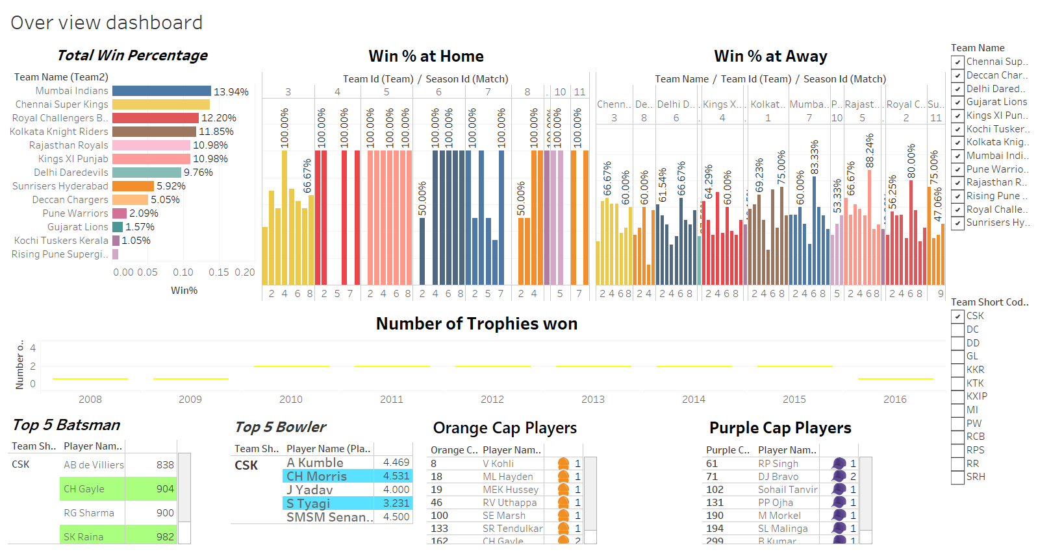

Slide 17
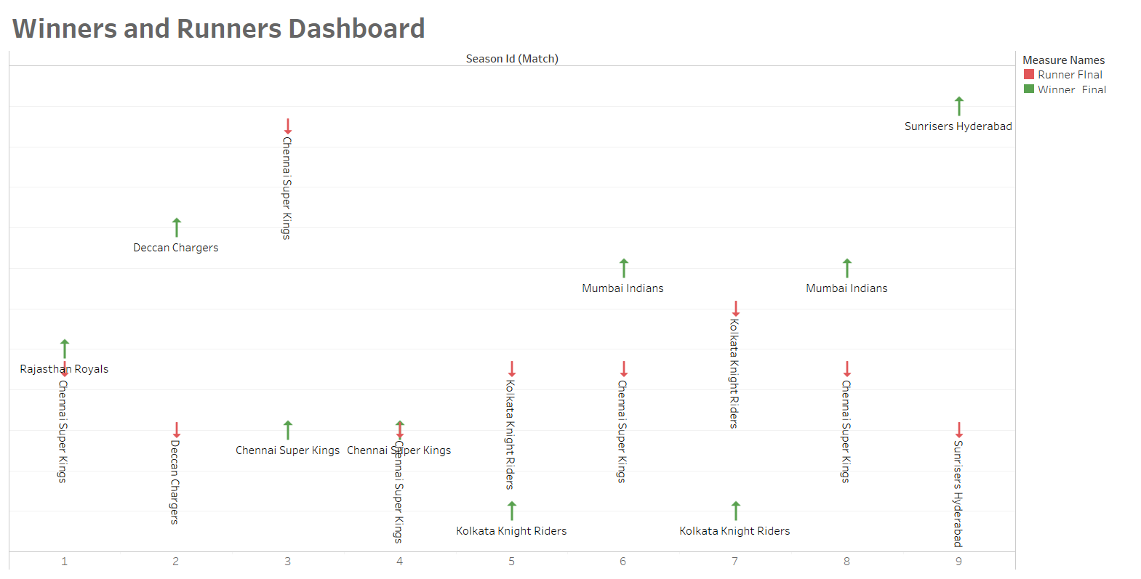

Slide 18
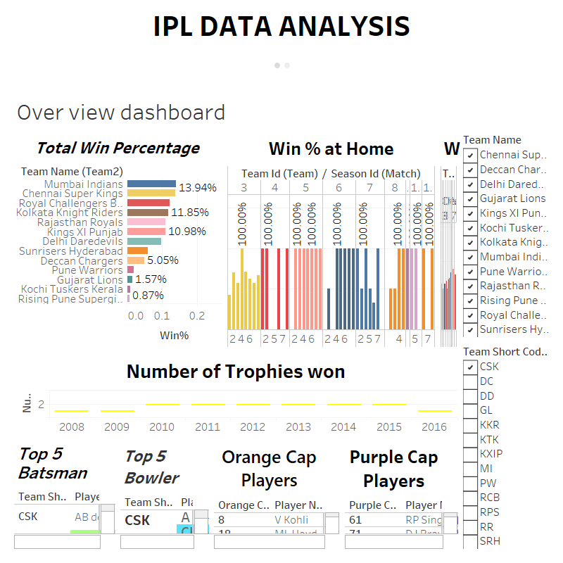

Slide 19
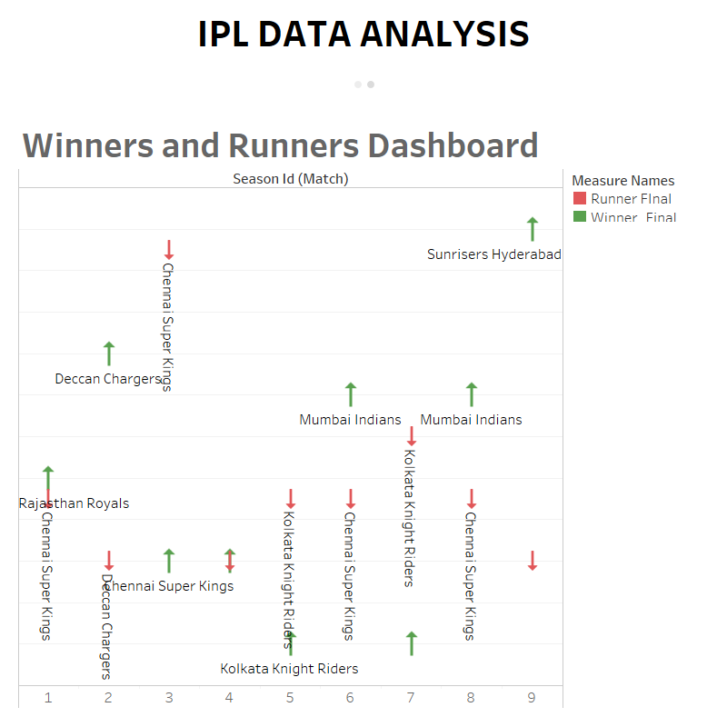

Slide 20
Dashboard link
https://public.tableau.com/views/IPLDATAANALYSIS_17155127973680/Overviewdashboard?:language=en-US&publish=yes&:sid=&:display_count=n&:origin=viz_share_link
https://public.tableau.com/views/IPLDATAANALYSIS_17155127973680/Winnerrunnerdashboard?:language=en-US&publish=yes&:sid=&:display_count=n&:origin=viz_share_link
Github Link url
https://github.com/Dharansakthi25/IPL-DATAANALYSIS_using_tableau

